Slide 1
ICLR 2026 PRESENTATION
Reasoning as Representation
Rethinking Visual Reinforcement Learning in Image Quality Assessment

Slide 2
The Core Discovery
Why do reasoning models generalize better in IQA?

Slide 3


The Current IQA Landscape
Conventional SFT MLLMs
The RL Reasoning Path
Supervised Fine-Tuning models like Q-Align directly regress scores. They lack descriptive depth and suffer from domain gaps in visual feature spaces.
Models like Q-Insight introduce step-by-step reasoning. They achieve superior generalization but incur massive inference latency and loading overhead.

Slide 4

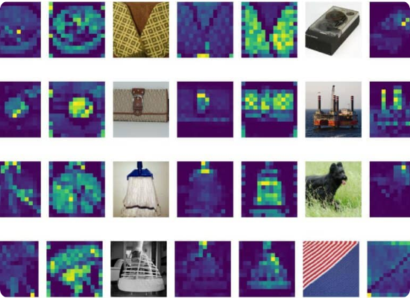
Shift from Visual to Textual tokens
The source of generalization revealed.
Attention heatmap analysis shows that during score generation, MLLMs assign 95% attention weight to reasoning text tokens.
RL training enables a 10x compression: mapping redundant 1000+ visual tokens to < 100 compact, cross-domain aligned text representations.

Slide 5
Bridging the Domain Gap
In high-dimensional visual spaces, different IQA datasets exhibit sharp domain disparities, leading to overfitting.
The Solution: Textual Representation
Text tokens alleviate these discrepancies. The reasoning processlearned on one dataset maintains stable alignment across diverse domains.

Slide 6
The RACT Framework
Reasoning-Aligned Cross-domain Training

Slide 7






RACT: Aligning Mixed Datasets
Label Alignment
SFT Convergence
Stable Scoring
Converts images into unified "image-text" labels using a reasoning module to neutralize dataset distribution bias.
Fine-tunes RL-trained models using aligned pairs, adapting the visual encoder across domains effectively.
Uses scores from only one dataset to prevent contradictory annotator biases during training.

Slide 8

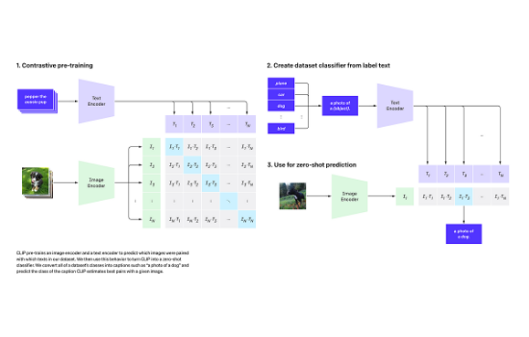
RALI: Lightweight Architecture
Reasoning-Aligned Lightweight IQA
RALI eliminates the need for multistep reasoning and LLMs during inference while matching MLLM performance.
Contrastive Alignment: Aligns vision encoder with textual quality space.
Feature Compression: PCA + Bucketed K-Means for basis vectors.

Slide 9

Similarity-based Scoring
RALI predicts scores by mapping images to a pre-constructed image quality text space via intra-space similarity.
PCA Projection: Reduces dimension from 768 to 512, filtering noise.
250 Basis Vectors: Representing 240 distinct bucket bins for coverage.
Weighted Sum of Basis Scores:
Pure Dot Product: Inference reduces to simple similarity calculation.

Slide 10
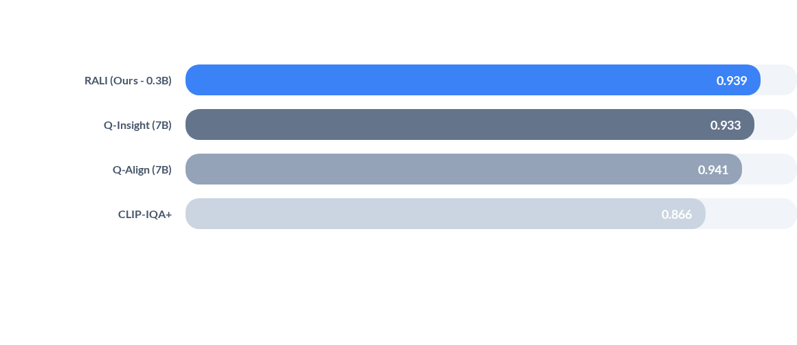
Performance Benchmark (PLCC)
RALI achieves accuracy on par with RL-based MLLMs while using only ~4% of parameters.

Slide 11
The Efficiency Breakthrough
Metric (Batch Size 16) | Q-Insight (Baseline) | RALI (Ours) | Efficiency Gain
GPU Memory | 19.0 GB | 2.8 GB | 85.3%
Inference Time | 8.3 s | 0.28 s | 96.6%
Parameters | 7.0 B | 0.3 B | ~95%

Slide 12
Thank You!

Slide 13
Image Sources

